Slide 1
jQuery $(Begins)

Slide 2
Admin Items

Slide 3
Feedback
C.A.S.K Feedback
Consensual: “Feedback should always be an invited item of communication. Just think of the last time you received un-asked-for advice from a family member.”

Slide 4
Feedback
C.A.S.K Feedback
Actionable: “Feedback needs to be actionable. Avoid vague adjectives like “bad” or “good,” if I cannot take steps to immediately act on your feedback it isn’t going to be useful in accomplishing the goal of my betterment.”

Slide 5
Feedback
C.A.S.K Feedback
Specific: “Feedback needs to be specific enough that I can actually come up with steps to change in response to the feedback. If the feedback is too general it does not help in the recipient’s betterment in ways that make more pleasant and productive interactions in the future.”

Slide 6
Feedback
C.A.S.K Feedback
Kind: “Be kind. Remember the goal of feedback. Hard to receive feedback that I want to take for my betterment when I’m too busy dealing with the emotional hurt from an unkind item of feedback.”

Slide 7
Feedback
Active Listening
“It requires that the listener fully concentrate, understand, respond and then remember what is being said.”

Slide 8
Lessons Learned

Slide 9
Lessons Learned
Variable Naming: Name your NOUNS
Use short enough and long enough variable names
Use specific names for variables
Use meaningful names for variables. Variable name must define the exact explanation of its content.
Obey programming language standards (CamelCase)
Don't reuse same variable name in the same class in different contexts

Slide 10
Lessons Learned
Variable Naming: Name your NOUNS
Don't use same variable for different purposes in a method, conditional etc. Create a new and different named variable instead.
Don't use too long variable names (e.g. 50 chars).

Slide 11
Lessons Learned
Function Naming: Name your VERBS
Use specific names for functions
Your function does something – the name should indicate what it does
Modularity: Your function should do ~One Thing

Slide 12
Lessons Learned
pseu·do·code: Plan your Track/ Stay on Track
a notation resembling a simplified programming language, used in program design.
//initialize passes to zero
//initialize failures to zero
//initialize student to one
//while student counter is less than or equal to ten
//input the next exam result
//if the student passed
//add one to passes
//else
//add one to failures
//add one to student counter
//print the number of passes
//print the number of failures
//if eight or more students passed
//print "raise tuition"
http://www.unf.edu/~broggio/cop2221/2221pseu.htm

Slide 13
Today’s Class

Slide 14
Objectives
In today’s class we’ll be covering:
DOM Manipulation using Plain Javascript
DOM Manipulation using jQuery
Responding to click events

Slide 15
Notes on what we’ll be covering:
Issues with jQuery syntax
the syntax will seem more intuitive over time
Next week there will be a portion class (Monday) allotted for reviewing JavaScript
Breathe…

Slide 16
DOM Manipulation

Slide 17
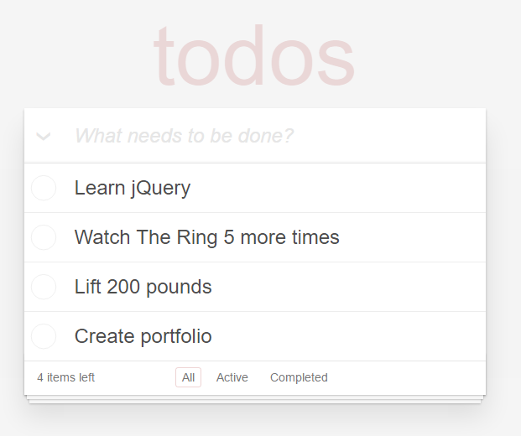
Understanding the “DOM”
Every HTML page begins as static content..
However, with Javascript / jQuery we can “modify the DOM” and change this static content in real-time.
This allows us to build dynamic sites.
Basic Example: http://todomvc.com/examples/jquery/#/all

Slide 18
Code Examination
Code Examination: JS Generators
(1-5.html | 1-JSGenerators)

Slide 19
Code Examination: JS Generators
1.html is intended to simply show the empty div empty-div that we've created. This div will be used to hold our dynamic content.
2.html is intended to show that we can "select" this div using document.getElementById. We can then populate the div using the innerHTML property. At this point, opening the file in the browser will showcase the text being displayed.

Slide 20
Code Examination: JS Generators
3.html is intended to show that adding another line of innerHTML will replace the earlier text..
4.html shows that this replacement can be corrected if we create a new div dynamically and use the appendChild method to display it as well.

Slide 21
Code Examination: JS Generators
5.html shows that we can use the setAttribute method to change the CSS style

Slide 22
> YOUR TURN!!
Activity: 2-JSDrinkList | Suggested Time: 15 min
Code Creation: Generating HTML with Javascript
Using the file in GitLab (2-JSDrinkList) as a starting point, add the missing code such that your Javascript generates HTML content that displays all of the drink options.
HINT: You will need a for-loop. Inside your for loop you will need to use each of the following methods: createElement, innerHTML, and appendChild.

Slide 23
>Code Examination
We utilized the getElementByID method to grab the div we'll be placing content into. We then store this element into a variable.
We then use a for-loop to loop through the drink list.
Inside the for-loop we continually create divs and change the innerHTML of each div to match the contents of each drink in the array.
Finally, we used the appendChild method to add the new divs we created to the original one.

Slide 24
Intro to jQuery

Slide 25
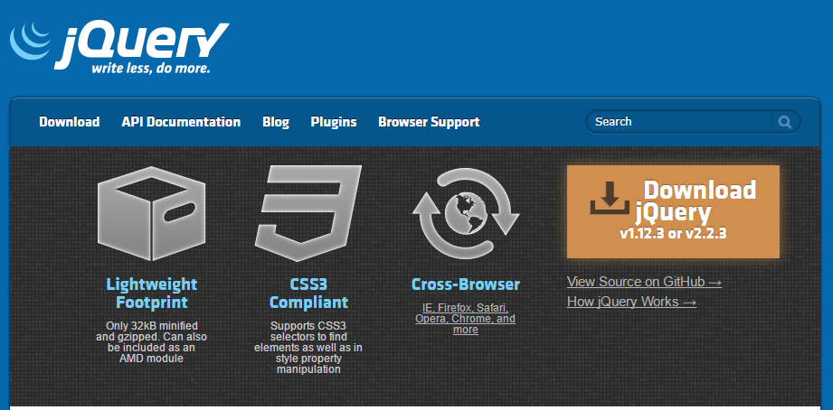
Intro to jQuery
https://jquery.com/
jQuery is a cross-platform Javascript library for easier of client-side HTML scripting.

Slide 26

jQuery Helper Library
jQuery can be useful for tasks like:
Dynamically Inserting, Updating, or Removing HTML
Registering click or other change events
Animating HTML elements
And much more!

Slide 27
jQuery Helper Library
JavaScript alone is not ideal for performing these kinds of HTML modifications. Instead, jQuery provides a simplified syntax for doing the same tasks.
"library" (i.e. a pre-built set of JavaScript methods that allow you to more easily perform functions.)
(similar to the concept of a CSS Framework like Bootstrap)

Slide 28
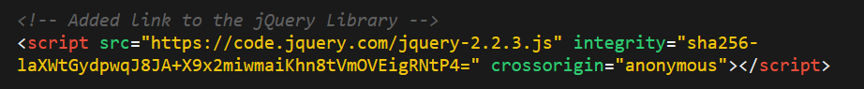
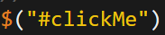
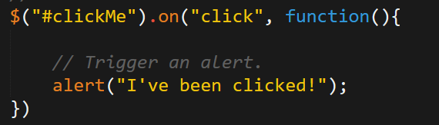
Working with jQuery generally involves…
1. Including a CDN (Content Delivery Network) Link to the jQuery script…
2. Utilizing the jQuery specific ($) selector…
3. Then applying jQuery methods on the selected elements.

Slide 29
Code Examination
Code Examination: 3-jQueryGenerators
(1-3.html | 3-jQueryGenerators)

Slide 30
Code Examination
1.html shows how we add in the jQuery library script at the top and that we use the $ selector to grab the div of interest. It also shows that we can change the HTML and append in just two lines. Be sure to point out how much simpler this is then the plain javascript version.
2.html points out that we could also create separate divs on the fly.
3.html points out that we can change the HTML class as well.

Slide 31
> YOUR TURN!!
Activity: 4-jQueryDrinkList | Suggested Time: 12 min
Code Creation: Generating HTML with jQuery
Re-factor (re-write) your previous drinkList code from earlier, but this time use jQuery to complete all of the same tasks.
Your final code should NOT have any of the following methods: createElement, innerHTML, or appendChild.
HINT: Don’t forget to “incorporate” jQuery before you begin.
BONUS: Instead of using a `for` loop try searching about the use of the jQuery `.each` method.

Slide 32
> 4-jQueryDrinkList
We used jQuery to grab the drink-options div.
We then created a new div and added content about the drinks (in a single line)
We then looped through and used the append to add the content to the page.

Slide 33
Code Examination
Code Examination: 5-OnClickBasic
(OnClick.html | 5-OnClickBasic)

Slide 34
Demo Time
The code has a jQuery selector to select the html element (button, header, anything)
It then has a .on('click', function(){}) syntax for capturing the event.
Inside that event's function is the code that results from the click.

Slide 35
> YOUR TURN!!
Activity: 6-SandwichClick | Suggested Time: 20 min
Code Creation: Click Events with jQuery
Add in the missing code such that clicking any of the sandwiches causes…
An alert message to popup saying something snarky about the sandwich type.
A second alert message that displays to the user the number of that specific sandwich they’ve eaten.
HINT: You will need counter variables.
BONUS: Add an image to the `image-div` on the click event.

Slide 36
Code Examination
The use of counter variables at the top.
The on-click events tied to each of the sandwich headers. The on-click events trigger the counter to go up and creates the alerts.

Slide 37
Code Examination
images can be added. Note that we are injecting HTML with the src pointing to the jpg.

Slide 38
Lunch: Return @ 12:45!!!

Slide 39
> YOUR TURN!!
Activity: 7-TriggerRandom | Suggested Time: 12 min
Code Creation: Generating Numbers with jQuery
Add in the missing code such that clicking the big blue button triggers a random number (between 1 and 1000) to be selected and prominently displayed in the randomNumber div.
Hint: None. You got this.

Slide 40
> Review
Activity: 7-TriggerRandom | Suggested Time: 12 min
Review: Triger Random:
We latched onto the random-button using its ID.
Focus your attention attention: Not the classes, and not the spans. The ID is what mattered in this case.

Slide 41
> Review
Activity: 7-TriggerRandom | Suggested Time: 12 min
Review: Triger Random:
We then created a click event tied to this random-button. This event triggers a random number between 1 and 1000 to be generated and printed to the HTML.

Slide 42
> YOUR TURN!!
Activity: 8-LotteryGenerator | Suggested Time: 20 min
Code Creation: Lottery Numbers with jQuery
Using the code from the previous random number generator as a starting point, create a lottery generator.
In our case, the lottery number should pick 9 random numbers (and always 9 numbers). As an example 886563264.
Display this number in the randomNumber div.
Then when a user clicks again, have the code create a new row with the latest number at the top.

Slide 43
> Review
Activity: 8-LotteryGenerator | Suggested Time: 20 min
Review: Lottery Generator
We needed to create a for loop that created 9 different numbers. Without this for loop, we couldn't guarantee that we'd have 9 numbers. We are using prepend as opposed to append so that the newest number shows up at the top.

Slide 44
> YOUR TURN!!
Activity: 9-NumberChecker | Suggested Time: 15 min
Code Creation: Lottery Numbers with jQuery
A computer picks a random number between 1 and 4
Users then “click” the buttons numbered 1 – 4.
If the user’s number matches the computer’s number, display text informing them that they won in the Result panel. Otherwise, display text informing them that they lost.
If you finish early, try to improve the aesthetics.

Slide 45
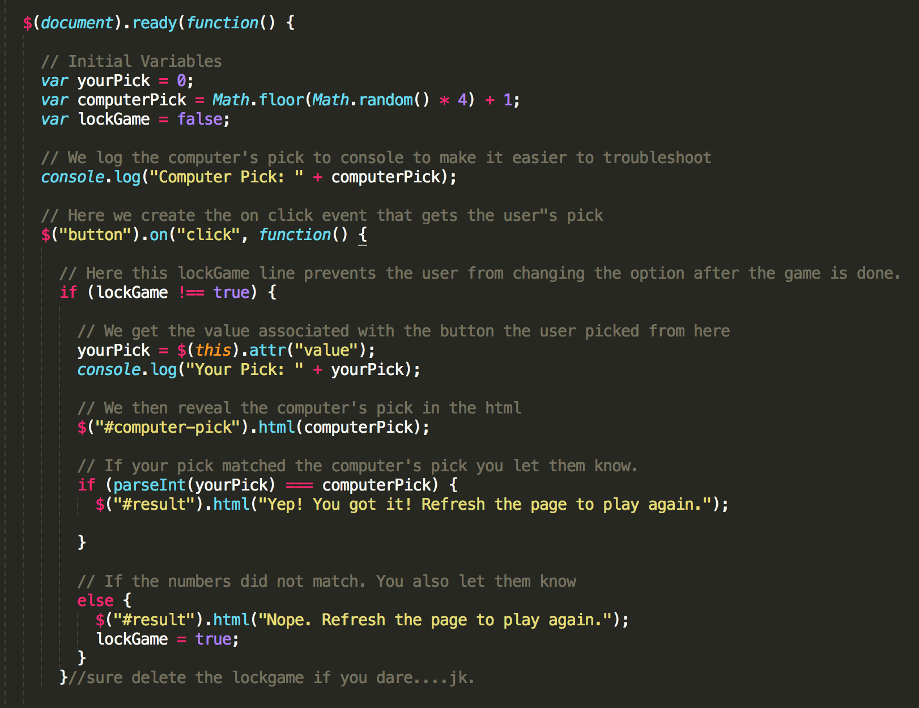
> Code Review: 9-NumberChecker

Slide 46
> YOUR TURN!!
Activity: 10-CaptainPlanetGame | Suggested Time: 25 min
Code Creation: Captain Planet Game!
Examine the code within 10-Captain Planet
Look at the jQuery API Docs (https://api.jquery.com/) and add a button of your own that gives Captain Planet a new power.
Examples:
Click to… Stretch Captain Planet!
Click to… Trigger a maniacal laugh!
Click to… Create clones of Captain Planet!
Click to… Create fire or water (hint: images)!
Yeah! https://youtu.be/BwkwKoZropI

Slide 47
> YOUR TURN!!
Activity: 10-CaptainPlanetGame | Suggested Time: 25 min
Examine the code within 10-Captain Planet
Dissecting the code - understand what is happening
Adding additional code to create a new power for Captain Planet.
Create a new button
Create a new on-click event, and then
Create code that changes the CSS for Captain Planet in response to button clicks.

Slide 48
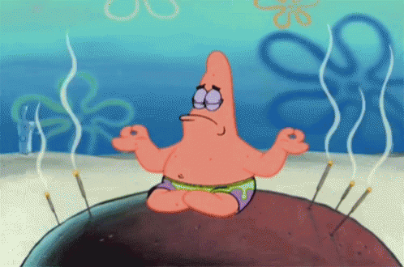
> Collective Breathe….just a couple more activities for today

Slide 49
> YOUR TURN!!
Activity: 11-FridgeGame | Suggested Time: 30 min
Code Creation: Fridge Game
Working in groups of 3, complete the code for the fridge activity such that:
JavaScript dynamically generates buttons for each of the letters on the screen.
Clicking any of the buttons leads the SAME letter to be displayed on the screen.
Hitting the clear button erases all of the letters from the fridge.*
**NOTE:** This is a challenging exercise. You may want one person to type, while the other two watch over to catch bugs and/or research necessary snippets.

Slide 50
> Review
Activity: 11-FridgeGame
The creation of an array that holds all of the letters;
The for loop used to take letters from the array, associate each with a data-attribute and text, and then append them onto the page. Students will be confused about the concepts of .addClass, .attr, and .text. Spend the time necessary to explain each.

Slide 51
> Review
Activity: 11-FridgeGame
The on-click event needed to capture button clicks. Be sure to point out how we use the data-attribute (via the .data method) to know which letter was clicked. This is a KEY POINT.

Slide 52
> YOUR TURN!!
Activity: 12-CrystalExample. | Remaining Time
Code Examination: CrystalExample
Working in groups of 2-3, discuss the code in ‘12-CrystalExample’:
Make note of what you find.
Make note of what confuses you
Use your Google-Fu to resolve any questions
If you are unable to find a solution as a group:
Breathe
Slack out your question to the class on the #_codingbootcamp channel

Slide 53
Questions?

Slide 54
Homework Time!

